Slide 2
Abstract
Diabetes patients have to continuously monitor their blood glucose levels and adjust insulin doses, striving to keep blood glucose levels as close to normal as possible. They need to take insulin dose before their every meal. The doctors have to decide insulin doses for every patient according to the patient’s previous records of doses and sugar levels measured at regular intervals. Our paper proposes a Machine Learning Approach & uses a RNN (LSTM) and ANN algorithm to predict the insulin chart for a patient efficiently to implement the model. The thirty six months chart maintained by the patient has been used to train the model and the long sequence of next insulin prediction is done on the basis of trained data. In this research, out of various existing algorithms of finding insulin level frequent item sets and mining association rule, we use predictive Apriori algorithm for this prediction.

Slide 3
Outline
Introduction
Motivation
The Key Concept
Existing Method
Problems
Background
Recurrent Neural Network
Artificial Neural Network
Predictive Apriori
Procedure
Data Set
Preprocessing
Our Prediction Method
Why its better
Result Analysis
Conclusion
Future Work

Slide 4
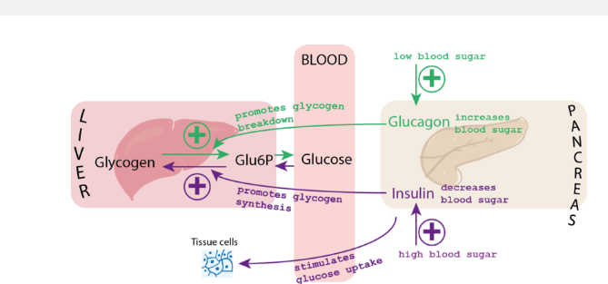
Introduction
Why need insulin on human body
Inadequate insulin secretion
Taking challenge of predicting insulin level

Slide 5
Motivation
Insulin Prevalence
Diabetes prevalence has been rising more rapidly in middle and low-income countries. The number of people with diabetes has risen from 108 million in 1980 to 422 million in 2014. The global prevalence of diabetes among adults over 18 years of age has risen from 4.7% in 1980 to 8.5% in 2014. A lack of insulin, or an inability to adequately respond to insulin, can each lead to the development of the symptoms of diabetes.
Control level of insulin
For a diabetes patient, insulin dose is necessary to control the level of glucose. The doctor of the patient also has to know the required insulin dose from previous records of doses & from patient’s current calculated blood sugar level. This has inspired us to make a research on how to predict the insulin dose level of a patient before every meal.

Slide 6
Existing Method
Using Hidden Markov model
Predict insulin level prediction
Predict hidden state
Predict next observable sequence of insulin level
Use Viterbi algorithm to calculate hidden state
Use simulated annealing to solve prediction level calculation
Similarity Calculation
Linear Regression
Logistic Regression
Random Forest

Slide 7
Problems
consider Sequence prediction HMM works like join rule probability.
It works Like (P(x1),P(x2|x1),(P(x3|x2,x1),which predict 3rd state with calculation of previous items.
Long Sequences have probabilities That approaches 0.
keep multiplying values <1
Each time need lamda calculation for each state predict that is too much time complexity.

Slide 8

Recurrent Neural Network (LSTM)
Whole RNN depends on Three gates
Forget Gate
f_{t} = σ (W_{f}. [h_{t-1}, x_{t}] + b_{f})
Input Gate
i_{t} = σ (W_{i}.[h_{t-1,} x_{t} ] + b_{i})
Candidate Layer
C_{t} = tanh ( W_{c}. [h_{t-1}, x_{t}] + b_{c} )
Output Gate
O_{t} = σ ( W_{o}. [h_{t-1}, x_{t}] + b_{o})
h_{t} = O_{t} * tanh C_{t}

Slide 9
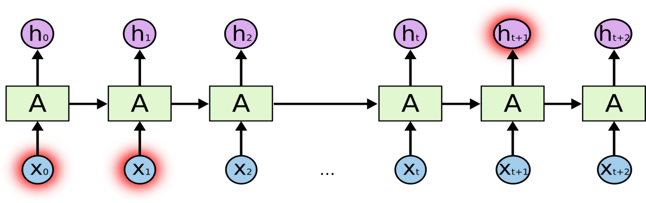
Recurrent Neural Network

Slide 10
RNN (LSTM) Cont.
Need a long sequence of data.
Data must be preprocessed.
Data must be with time series and Date.
For next insulin value prediction need One column of data.

Slide 11
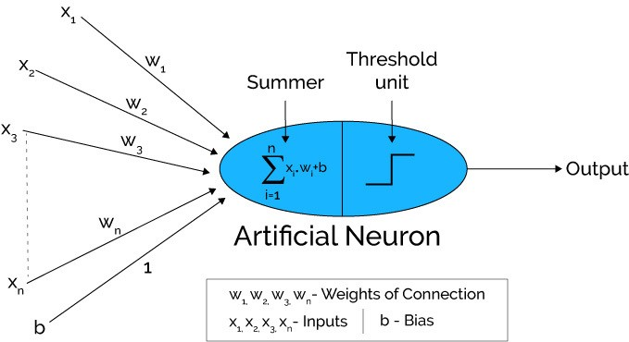
Artificial Neural Network
The Artificial Neural Network receives input from the external world in the form of pattern and image in vector form. These inputs are mathematically designated by the notation x(n) for n number of inputs.
Each input is multiplied by its corresponding weights. Weights are the information used by the neural network to solve a problem. Typically, weight represents the strength of the interconnection between neurons inside the neural network.
The weighted inputs are all summed up inside computing unit (artificial neuron). In case the weighted sum is zero, bias is added to make the output not- zero or to scale up the system response. Bias has the weight and input always equal to ‘1’.
The sum corresponds to any numerical value ranging from 0 to infinity. In order to limit the response to arrive at desired value, the threshold value is set up. For this, the sum is passed through activation function.

Slide 12
Predictive Apriori
Predictive Apriori Algorithm:
This algorithm searches with an increasing support threshold for the best 'n' rules concerning a support-based corrected confidence value.
A rule is added if the expected predictive accuracy of the rule is among the 'n' best and it is not subsumed by a rule with at least the same expected predictive accuracy.
Predictive Accuracy:
Predictive accuracy is generally used for the Predictive Apriori rule measurement. According to Scheffer , definition of predictive accuracy is as follows: Let D be a data file with n number of records.
If [x → y] is an Association Rule which is generated by a static process P then the predictive accuracy of [x →y] is c([x → y])=P[n] satisfies y|n satisfies x]where distribution of r is given by the static process P and the Predictive Accuracy is the conditional probability of x→n and y→n.

Slide 13
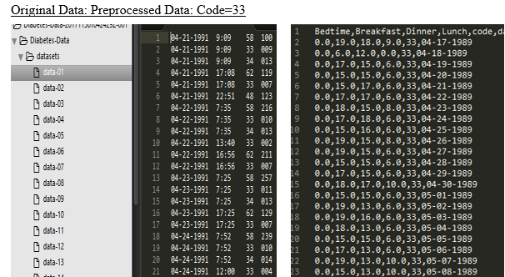
Data Set and Preprocessing
33=Regular Insulin dose
54=NPH insulin dose,
35=Ultralente insulin dose,
48=Unspecified blood glucose measurement,
57=unspecified blood glucose measurement etc.

Slide 14

Methodology
Raw Diabetes
Dataset
Preprocess Diabetes Dataset
Code=33
Apply Recurrent neural network (LSTM)
Use Artificial Neural Network
Apply Predictive Apriori Algorithm
Prediction sequence of insulin level and next state insulin level
Predicting frequent item set and association rule with accuracy
Prediction on train data with accuracy

Slide 15
Load Dataset from
Csv file(use SciPy environment with keras and backend theano or tensor flow
Fit random seed(using numpy.seed()
Load dataset as pandas data frame.(Extract NumpyArray
Normalize data(rescale our data 0 to 1 using MinMaxScaler in Scikit Learn Library
Fit LSTM network(1 input,4 LSTM block,1 Output layer for prediction
Reshape data(need samples, timesteps and features)
Convert array of values into dataset matrix.(look_back for previous step)
Split the dataset(67% train and 33% test)
Make prediction(calculate RMSE)

